Slide 1
Building Computational Virtual Reality Environment for Anaesthesia (CVREA)
Chirath Abeysinghe, professor: jing he and Dr: Jia Rong

Slide 2
Content
Introduction
Methodology
Output
Coding
Demonstration
Challenges
Q & A

Slide 3
Introduction
Our aim is to build the Computational Virtual Reality Environment for Anaesthesia (CVREA) using virtual reality (VR), data mining, and machine learning techniques.
In proposed method, using a webcam which will be placed in front of the real medical monitor and each webcam will get physiological parameters of the patient.
we can generate and simulate the actual anaesthesia surgery based on the video gathering using VR devices.
Need a way to convert those video sequence of physiological data into standard format to feed the training and learning system

Slide 4
Methodology
Retrieve the video stream of the monitor through a camera
Break it into Image Frames
Extract the Signal Patterns
Convert the Image Patterns to XY Coordinates.
Feed them into Training and Learning System
Make Predictions
Convert RGB (0-255) to Grayscale Images (0-1)
Load the video stream into Python software environment
Still the pattern is sparse Matrix of 0 and 1
Then, represents each frame as a one data point by taking the mean value of it.
Apply frequency based filter to identify critical events.
Apply PCA based Algorithm (New) to predict the potential crisis
Currently indicates abnormalities in Red colour. Otherwise in Green colour
In future, it can propose possible treatments through Game Theory.
Value 1 means white pattern and 0 means dark background
Apply Image Analysis algorithm to reduce the noise (ex: Gaussian Blur)
Take the index values and normalize them between 0 and 100
Then, convert into a new data sequence

Slide 5
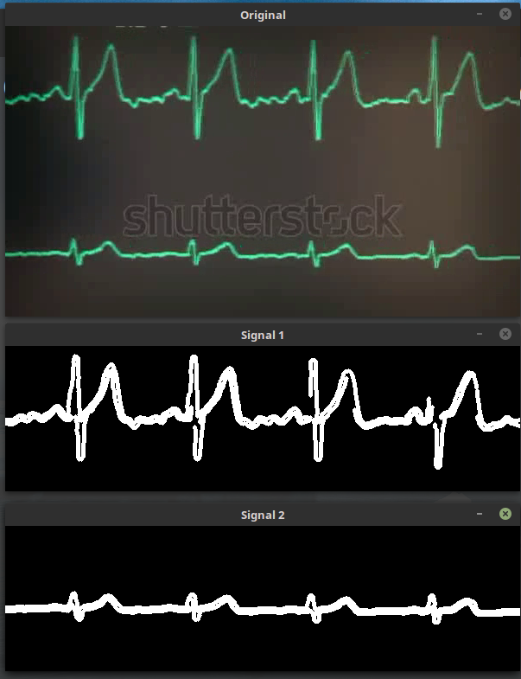
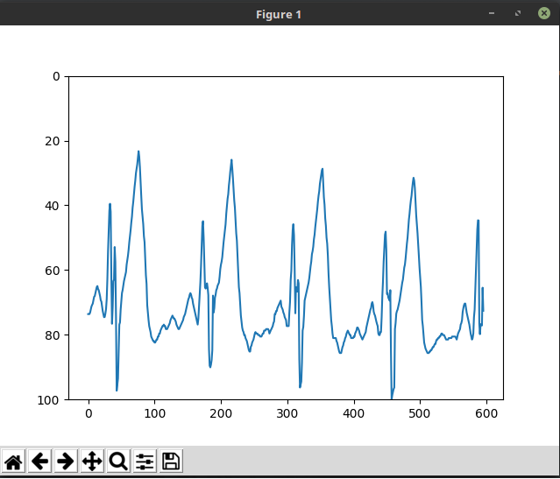
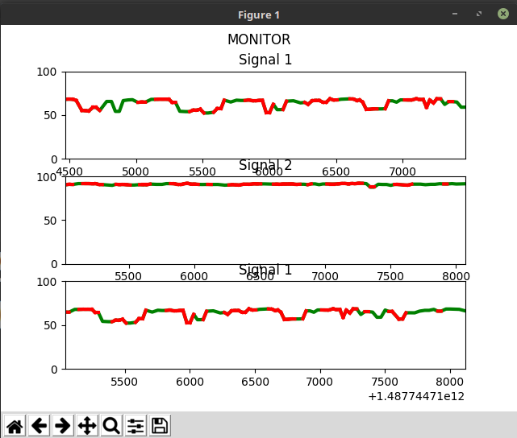
Output

Slide 6
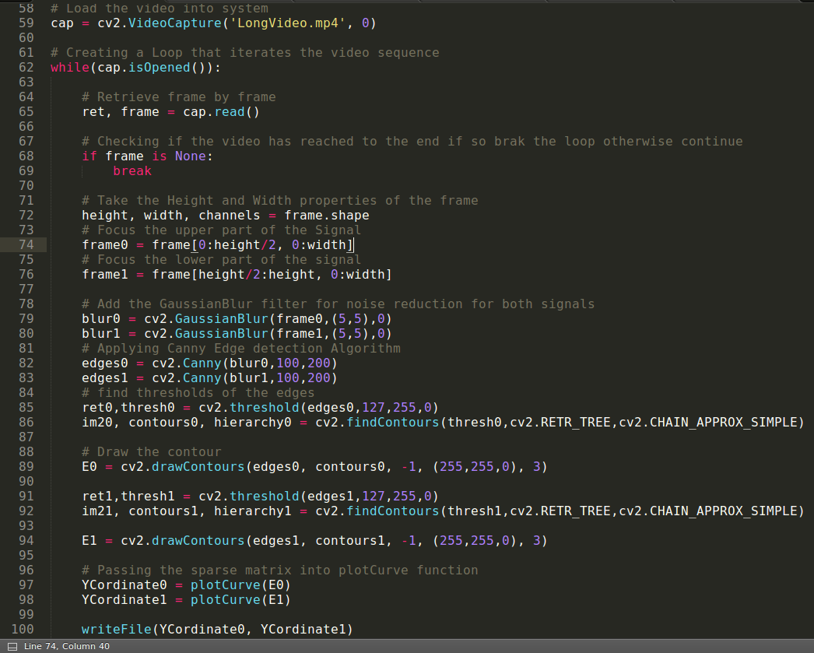
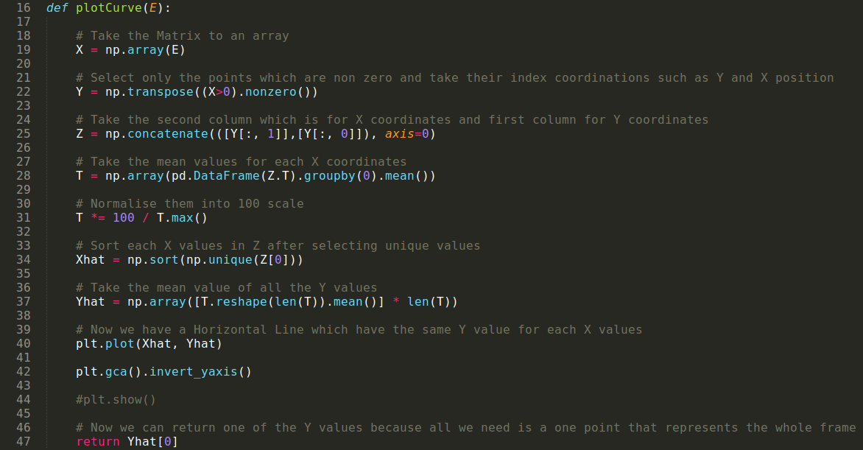
Coding

Slide 7
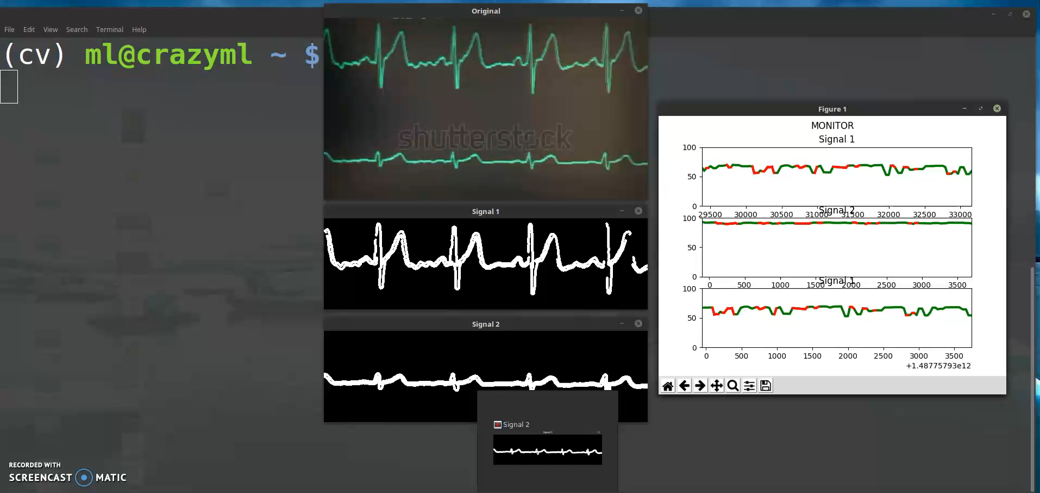
Demonstration

Slide 8
Challenges
The system still needs high computational power to work efficiently.
The coding of the developed system need to be computationally optimized in order to run faster.
It was very difficult to find real time data, so that synthetic data have been used all the time.
Lack of samples to test the system in variety of situations for validation.

Slide 9
Q & A

